Slide 1
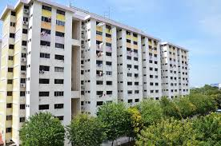
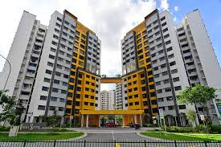
HDB Resale Flats Dashboard Report
Tan Wei Zhi Daryl
Notes:
Hello everyone! My name is Daryl and today I will like to present the HDB Resale Flats dashboard report. It will contain many meaningful insights and help you to better understand the real estate market in Singapore.

Slide 2

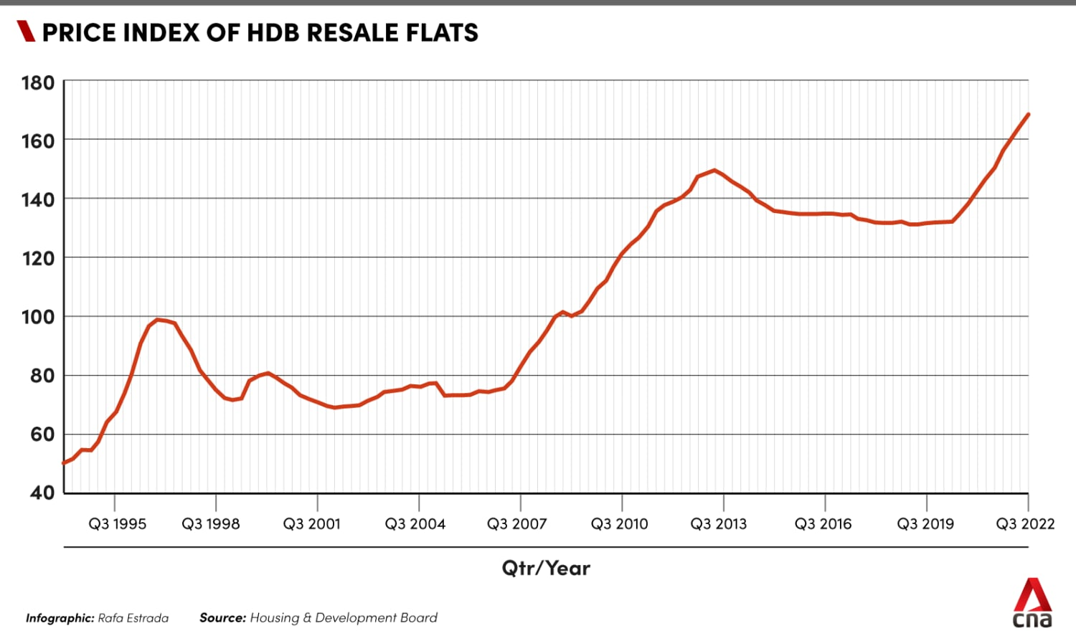
General Process
Problem Statement
Research Objective
Data Preparation
Report
Conclusion
Notes:
I will be going through the following points, Problem statement, the research objective, how I clean and prepare the data, the report of the data and lastly the conclusion of the project.

Slide 3


Problem Statement
Accurate property valuation
Plays a crucial role in making informed buying & selling decisions
Target Audience
Property owners
Investors
Real estate professionals
Purpose
Determine fair market prices
Negotiate deals
Investment opportunities
Notes:
In the real estate industry, accurate property valuation plays a crucial role in making informed buying and selling decisions. Property owners, investors, and real estate professionals rely on accurate and reliable valuation estimates to determine fair market prices, negotiate deals, and assess investment opportunities.

Slide 4
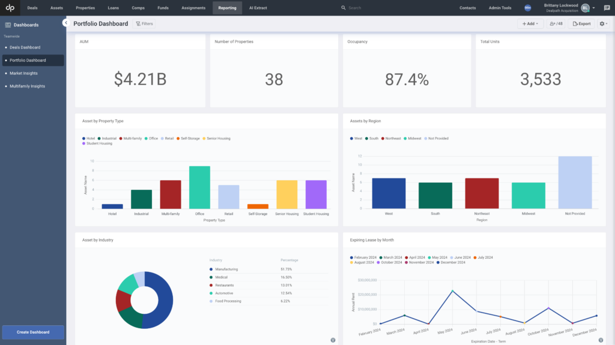
Research Objective
Dashboard Purpose
Comprehensive dashboard for descriptive analytics
Key Factors
Location
property characteristics
market trends
comparable sales data
Easy to understand
Aim to create a user-friendly and informative dashboard
Improves understanding of real estate market
Notes:
The goal of this project is to develop a comprehensive dashboard for descriptive analytics in the real estate industry. The dashboard will provide users with valuable insights and visualizations based on key factors such as location, property characteristics, market trends, and comparable sales data. Moreover, I also aim to create a user-friendly and informative dashboard that improves the understanding of the real estate market in Singapore.

Slide 5
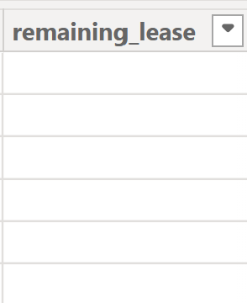
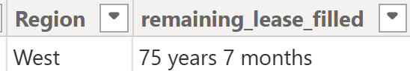
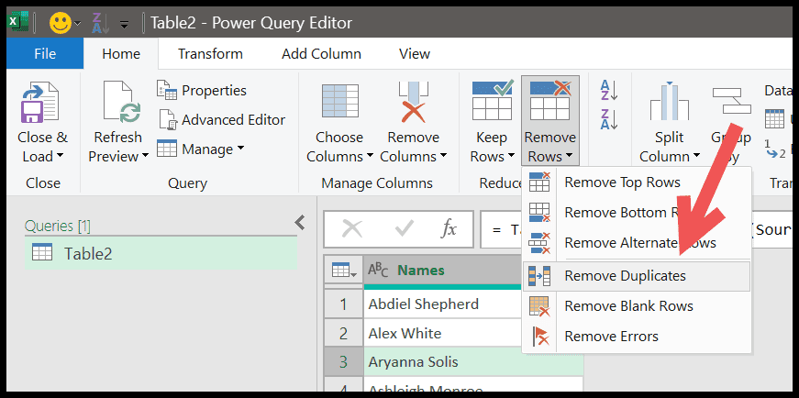
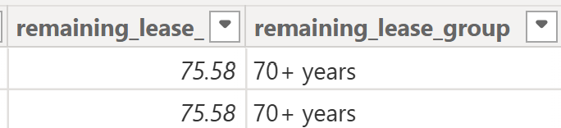
Data Preparation Overview
How I clean the data
Removing unnecessary data (Duplicates)
Filling in blank values of remaining lease
Adding new columns
Notes:
Before analysing any data, data preparation is a very important step. I will talk about how I clean the data, removing unnecessary data, for example, duplicates. Next, I will show you how I fill in the blank values of remaining_lease column in the data set. Lastly, I will show you how I add new columns to the existing data set.

Slide 6
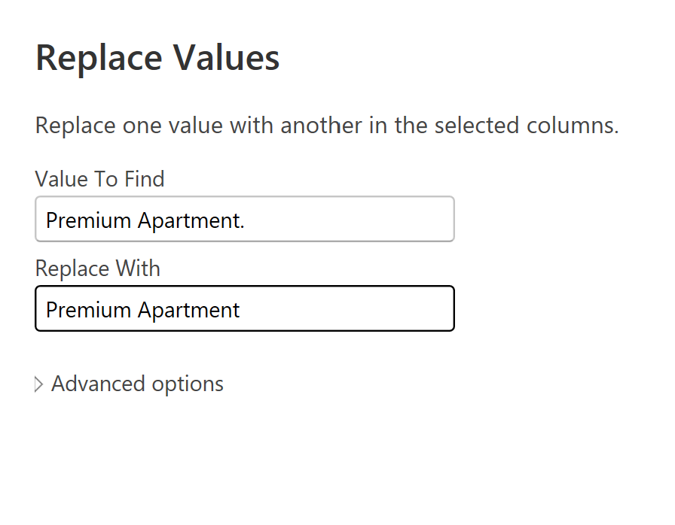
Data Preparation
Flat Model Column
Premium Apartment
Premium Apartment.
Clean and trim the column
Format -> Trim -> removes trailing spaces
Format -> Clean -> removes non-printable characters
Transform -> Replaces Values
Value to find: Premium Apartment.
Replace with: Premium Apartment
Notes:
From the Flat model column, we can see that premium apartment and premium apartment full stop appears. They both mean the same thing. Firstly, I go to format, followed by trim to remove the trailing spaces. Next, I go to format, followed by clean, to remove non-printable characters. After that, transform, replaces values, for value to find, we type premium apartment full stop. For replace with, we type premium apartment. This will make sure that only premium apartment appears in the column.

Slide 7
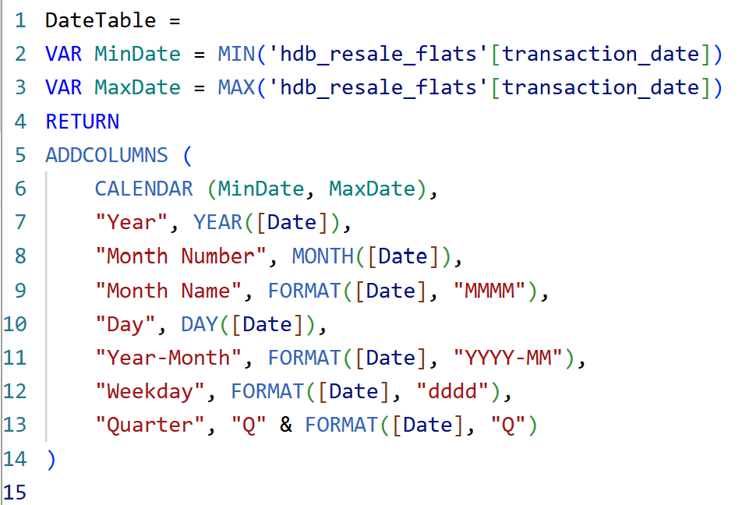
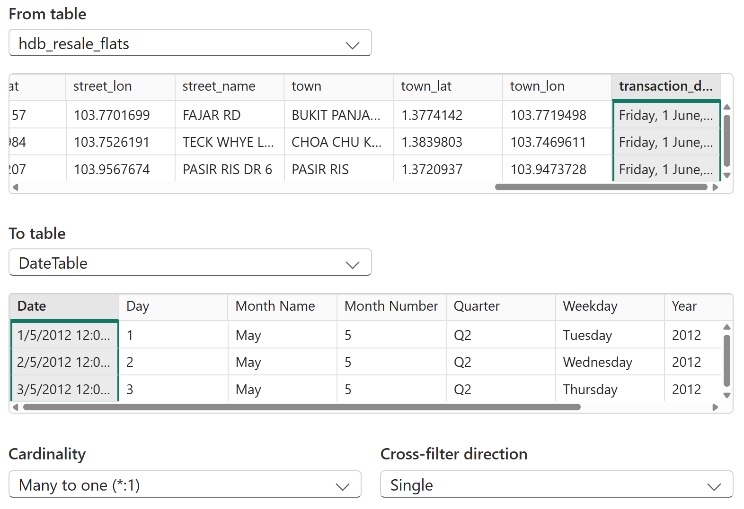
Data Preparation
Create a date table from month column
Change name to transaction_date
Change transaction_date to date type
Go to modeling tab -> New Table
Enter the DAX formula
Mark as Date Table
Go to model view
DateTable[Date] ⟶ hdb_resale_flats[transaction_date]
Notes:
From the month column, I can create a date table. First, I change the month name to transaction_date. This allows a more meaningful name. Next, I change to date type. After that, go to modeling tab, select new table, enter the DAX formula. Next, I mark as date table. Lastly, I go to model view, to create the relationship between date table and hdb resale flats.

Slide 8
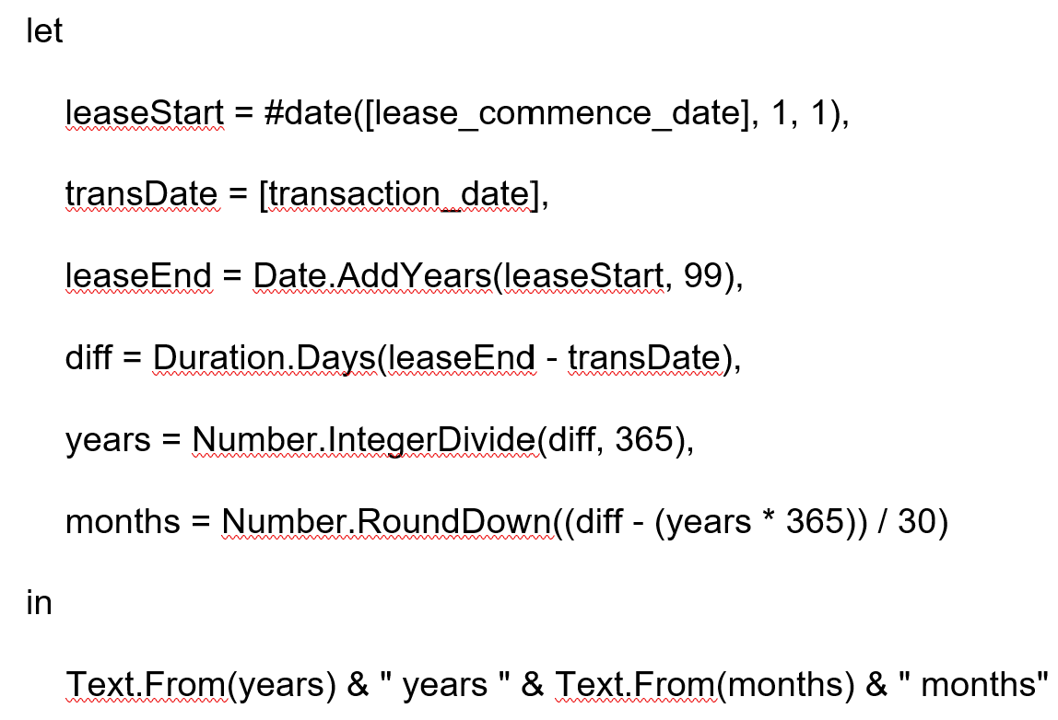
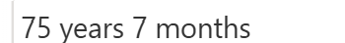
Data Preparation
Remaining Lease Column (Many Blanks)
Add Column -> Custom Column
New Column: remaining_lease_calculated
Type in the formula
Change data type to whole number
Fill up the blanks of remaining_lease with the calculated values
Notes:
For the remaining lease column, I notice that there are many blanks. We need to create a custom column called remaining lease calculated. Type in the formula as shown from the image and change data type to whole number. Once done, we want to replace the blanks with the calculated remaining lease values. For those original values that are in remaining lease column, we don’t do anything to them.

Slide 9
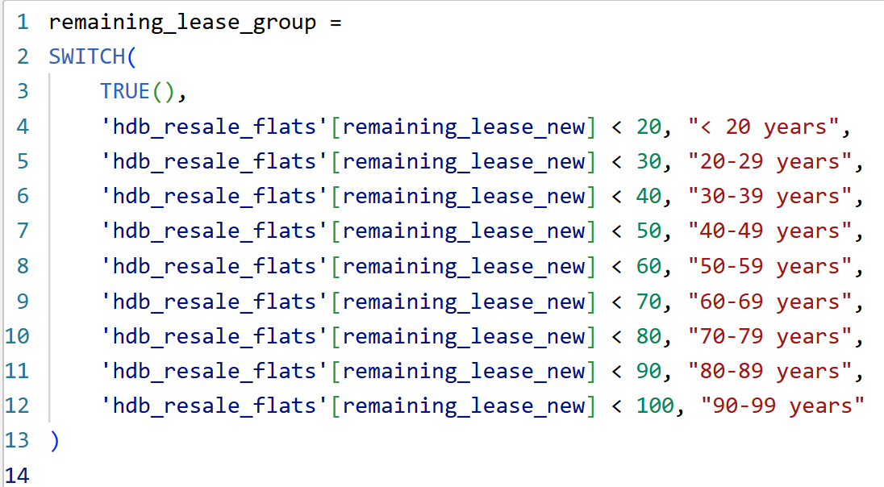
Data Preparation
Remaining lease group (New Column)
Click table icon (Table View)
Table tools -> New Column
Write the DAX formula
Notes:
We can create a column called remaining lease group. First, we click table icon (Table View). Next, table tools, new column and write the DAX formula as shown in the image. This will categorize the remaining lease into groups, for example, 90-99 years. This will help to easily see quickly which resale flats are newer and which are older.

Slide 10
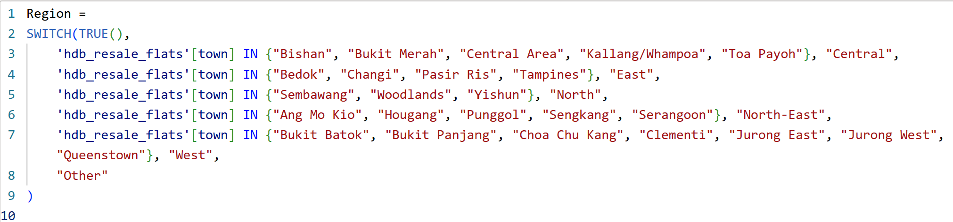
Data Preparation
Region (New Column)
Click table icon (Table View)
Table tools -> New Column
Write the DAX formula
Notes:
We can create a new column called region. First, we click table icon (Table View). Next, table tools, new column and write the DAX formula as shown in the image. This will categorize the town into areas like central, east, north.

Slide 11
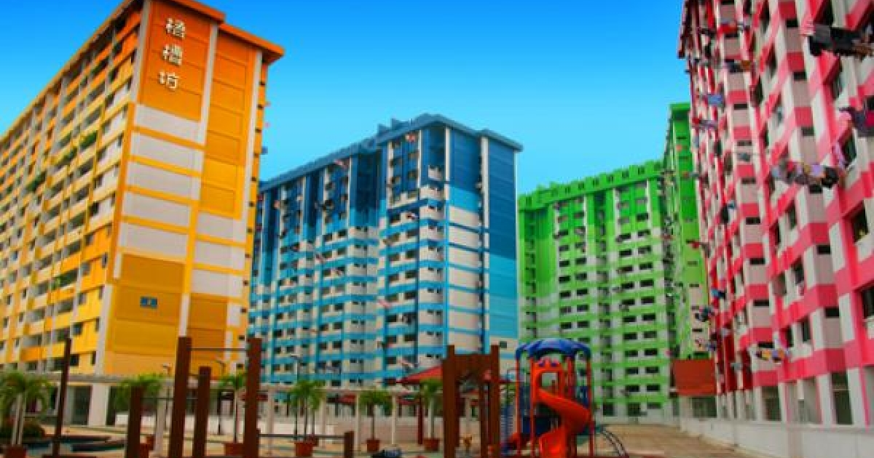
Report
Discuss the 5 different dashboards
HDB Resale Flats Overview
Location Analysis
Property Characteristics
Market Trend
Future Projection
Notes:
I will like to talk about the 5 power BI dashboards that I have created, namely, the HDB resale flats overview, location analysis, property characteristics, market trend and lastly future projection.

Slide 12
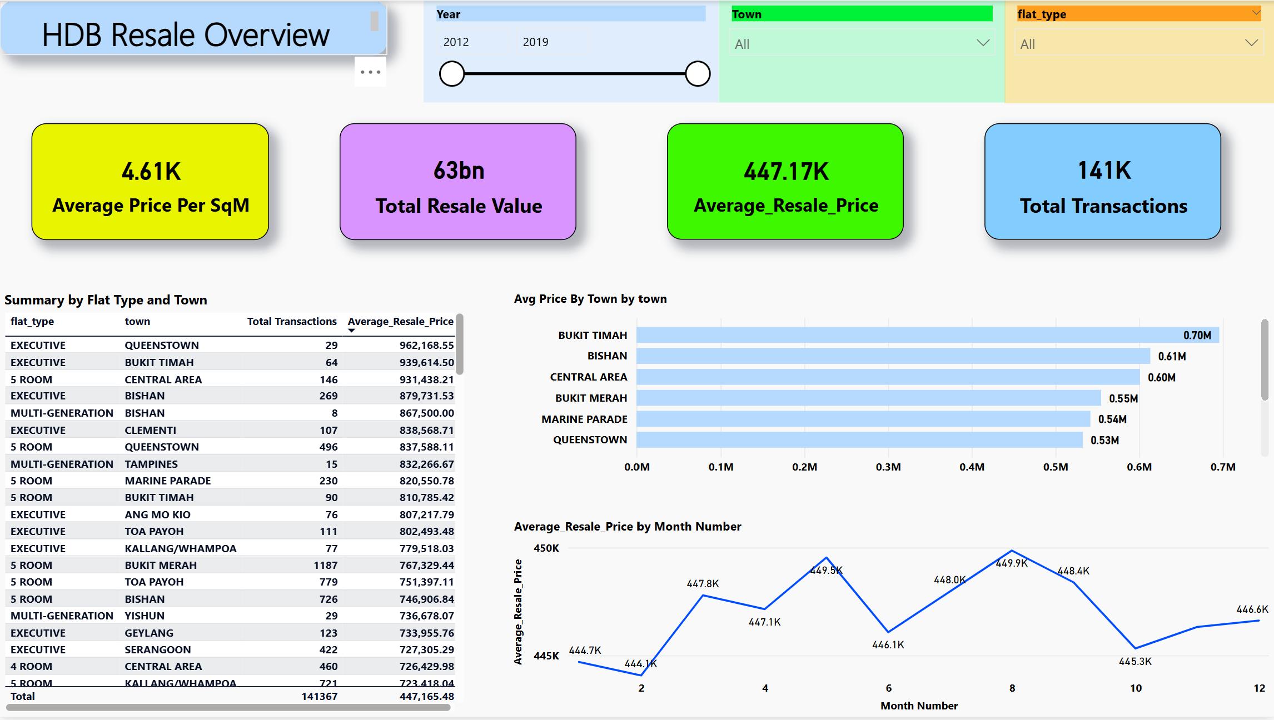
Dashboard 1: Market Overview
Notes:
This is dashboard 1, where it shows the market overview of the HDB resale flats in Singapore. As seen from the card, the average price per square meter is 4.61 thousand. The total resale value is 63 billion. The average resale price is 447.17 thousand. The total number of transactions is 141 thousand.
On the left, I have a table summary showing the flat type and town. On the right, I have a clustered bar chart showing the average price and the town.
I also have a line chart showing average price and the month.

Slide 13
Dashboard 1 Summary
Top 3 average resale price: Executive / 5 Room / Multi Generation
Top average price by town: Bukit Timah
Top 2 months average resale price: May / August
Notes:
I have also summarized dashboard 1 for easier reference of the insights.

Slide 14
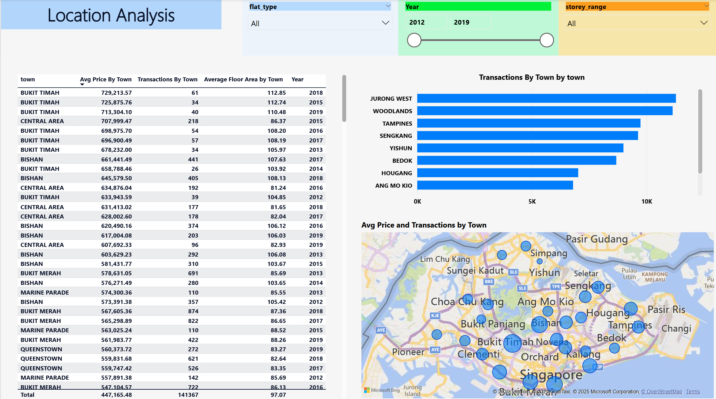
Dashboard 2: Location Analysis
Notes:
This is dashboard 2, where it shows the location analysis. I have a clustered bar chart showing the average price and the town. I have a clustered bar chart showing the number of transactions and the town. I also have a summary table showing the town, average price and floor area. Lastly, I have a map which shows the average price by town, the bigger the bubble, the higher the average price.

Slide 15
Dashboard 2 Summary
Top 3 Average Price by town: Bukit Timah / Bishan / Central Area
695.87K 613.46K 601.05K
Top 3 Transactions by town: Jurong West / Woodlands / Tampines
11283 11140 9738
Top 3 Average floor area by town: Pasir Ris / Choa Chu Kang / Bukit Timah
122.75 110.93 108.81
Notes:
I have summarized dashboard 2 for easier reference of the insights.

Slide 16
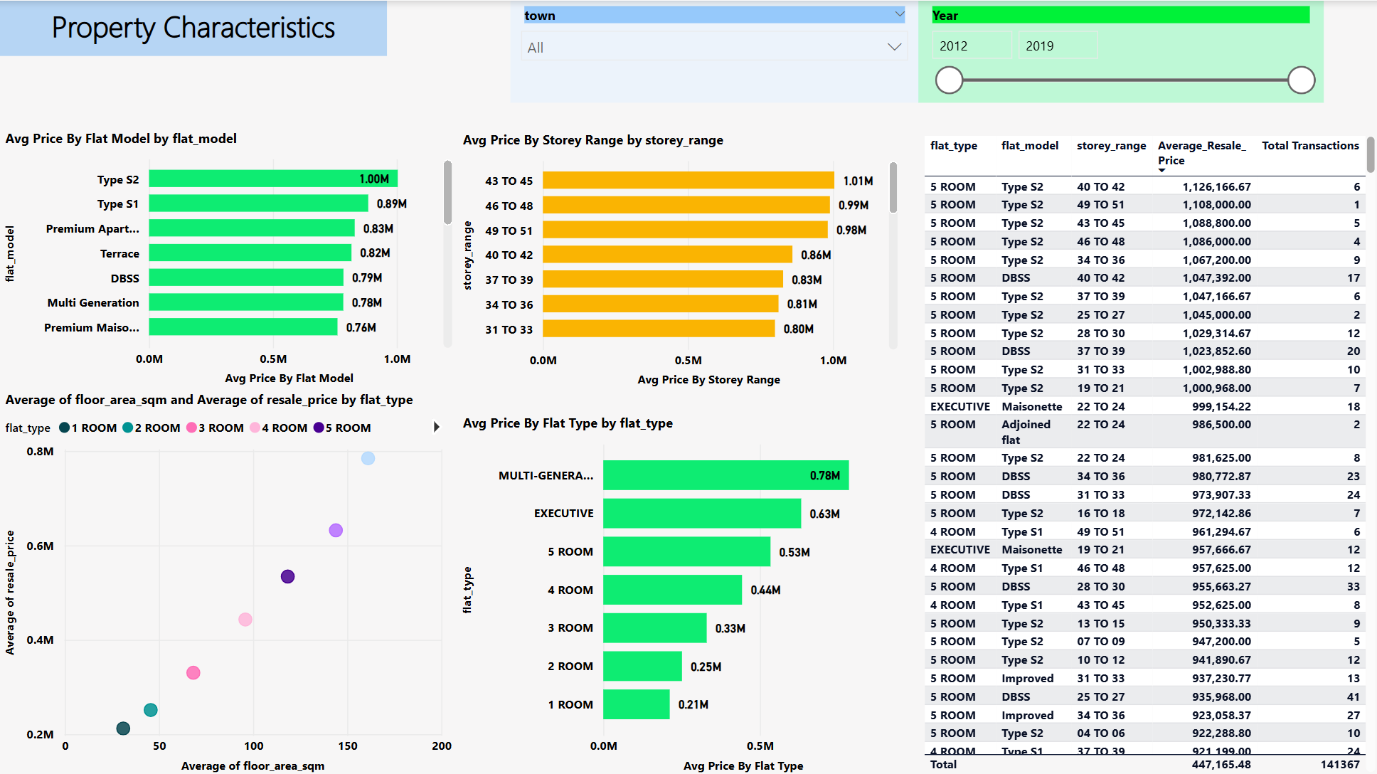
Dashboard 3: Property Characteristics
Notes:
This is dashboard 3, where it shows the property characteristics. I have a clustered bar chart showing the average price by flat model. This helps us to see which flat model is generally more expensive. Next, I have a clustered bar chart showing the average price by storey range. This helps us to see that the higher the storey, the more expensive the flat is. I have a clustered bar chart showing the average price by flat type. We can see that multi-generation and executive are relatively more expensive compared to the rest. I also have a scatter chart showing the average floor area sqm and average resale price. We can clearly see that the greater the floor area, the more expensive the hdb flat.

Slide 17
Dashboard 3 Summary
Top 3 Avg Price by Flat Model: Type S2 / Type S1 / Premium Apartment
Top 3 Avg Price by Storey Range: 43 to 45 / 46 to 48 / 49 to 51
Top 3 Avg Price by Flat Type: Multi-Generation / Executive / 5 Room
Avg Resale Price > 1M: 5 Room Flat (Type S2 / DBSS)
Total Transactions > 5000: 4 Room Flat (Model A)
Notes:
I have also summarized dashboard 3 for easier reference of the insights.

Slide 18
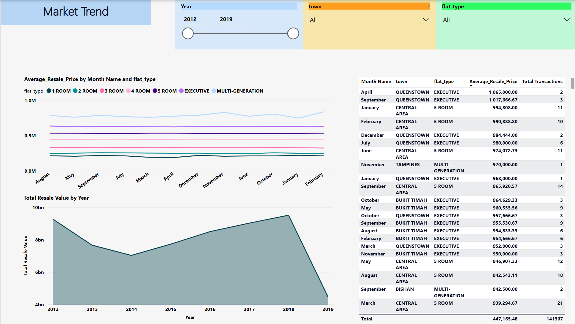
Dashboard 4: Market Trends
Notes:
This is dashboard 4, where it shows the market trends. I have a line chart showing the average resale price by month and flat type. We can clearly see that November and February had the highest resale price. Moreover, Multi-generation and executive are generally more expensive than the rest. Next, I have an area chart showing the resale value by year. We can see that from 2014 to 2018, the total resale value increases gradually. However, it dropped significantly from 2018 to 2019.

Slide 19
Dashboard 4 Summary
From 2012 – 2018: Total Resale value from 7 to 9.5 Billion
Dropped greatly from 9.5 Bn in 2018 to 4.5 Bn in 2019
Average Resale Price > 1M: Queenstown / Executive / April & September
Total transactions > 500: Sengkang & Woodlands / 4 Room / April & May
Notes:
I have also summarized dashboard 4 for easier reference of the insights.

Slide 20
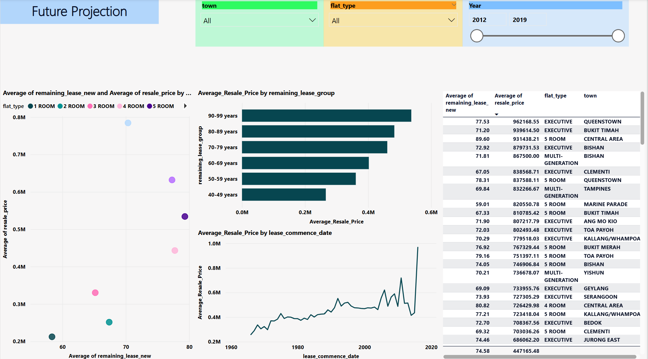
Dashboard 5: Future Projection
Notes:
This is dashboard 5, where it shows the future projection. I have a scatter chart showing the average remaining lease and average resale price. We can see that the greater the remaining lease, the greater the resale price. I have a clustered bar chart showing the average resale price by remaining lease group. Next, I have a line chart showing the average resale price by lease commence date. We can see that the newer the flat is built, the greater the resale price of the flat.

Slide 21
Dashboard 5 Summary
Remaining lease > 90 years: Avg resale price 536.88K
Sharp spike of Avg resale price from 2014 to 2016
Multi-Generation / Executive & high remaining lease years fetch highest resale price
Notes:
I have also summarized dashboard 5 for easier reference of the insights.

Slide 22
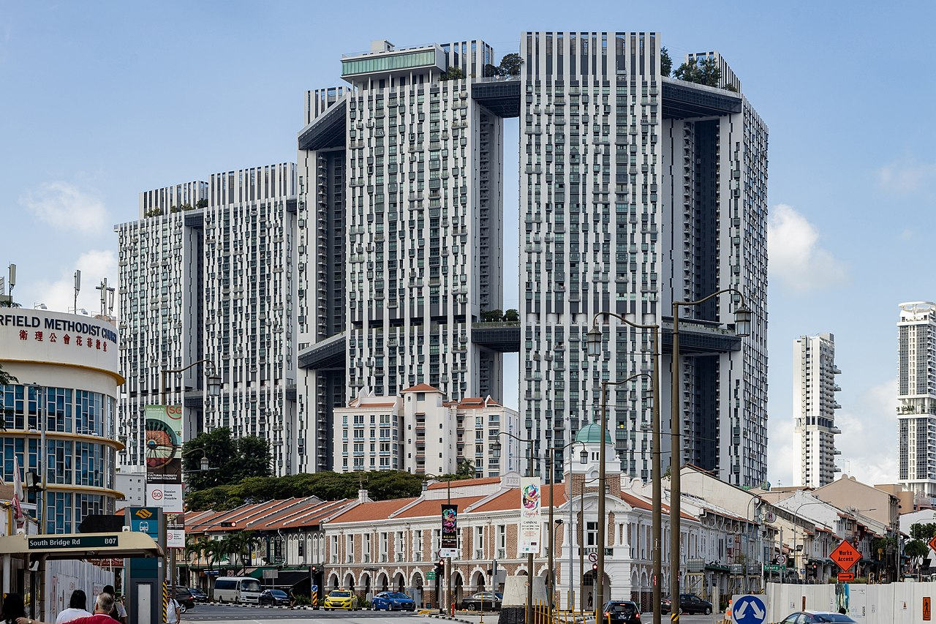
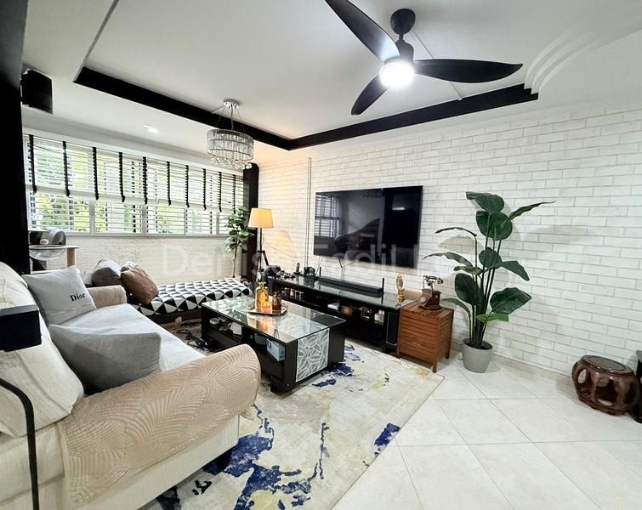

Conclusion
The dashboards help to uncover pricing trends & insights in HDB resale flats
Location (Bukit Timah / Central Areas) greatly affects price
Property characteristics (Flat Type / floor level) impact value
Market trends reveal price dips and rebounds tied to economic changes
Notes:
After going through the 5 dashboards, they help to uncover pricing trends and insights in HDB resale flats. The location, for example, Bukit Timah and central areas greatly affects price of flats. Property characteristics, for example, flat type and floor level, also impacts the value of the flats. Lastly, market trends reveal price dips and rebounds tied to economic changes.

Slide 23
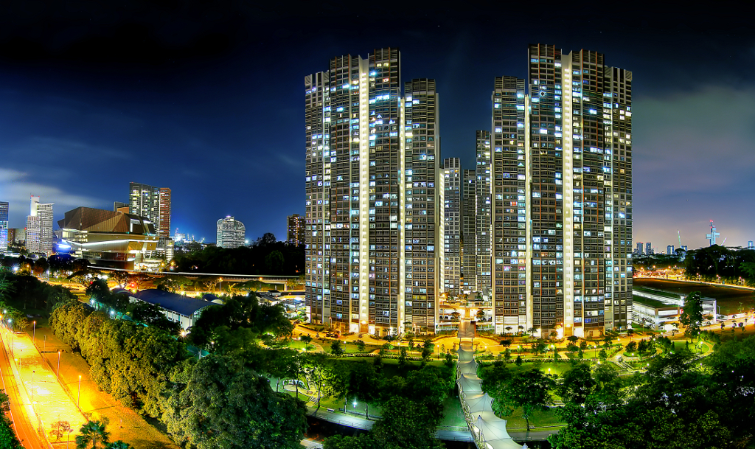
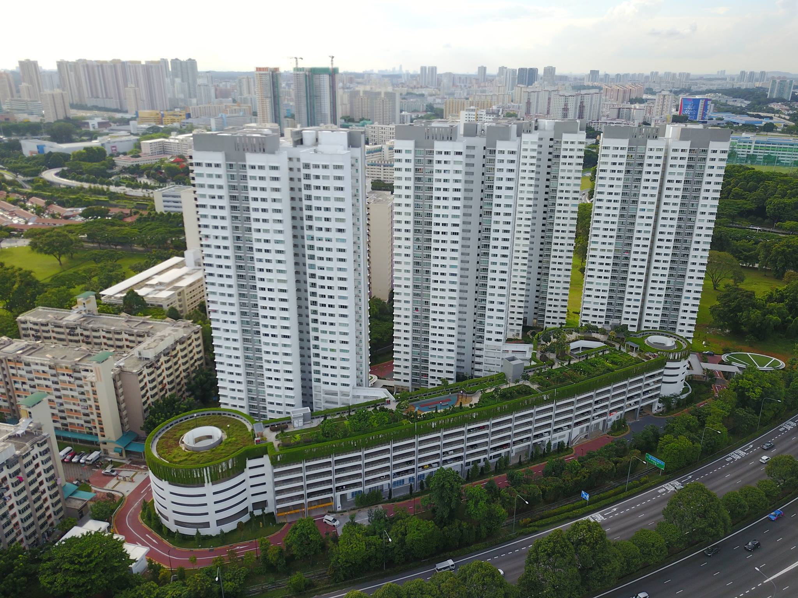
Recommendation
For Buyers / Investors
Executive & 5 room flats show strong long term value
Consider towns with high floor area & moderate price per sqm
For Sellers
Time sales during months with higher average resale price (May / August)
Highlight premium attributes (high storey and location)
For Policymakers
Monitor sharp spikes for speculative activity
Notes:
My recommendation for buyers and investors are to buy executive or 5 room flats, which show strong long term value. They also consider towns with high floor area and moderate price per square meter.

Slide 24

Notes:
With this, it comes to the end of my presentation. Thank you for your kind attention and do let me know if you have any questions. Thank you!

